Slide 1
Chukchi Prelim OM Results
16 March 2021 Meeting

Slide 2
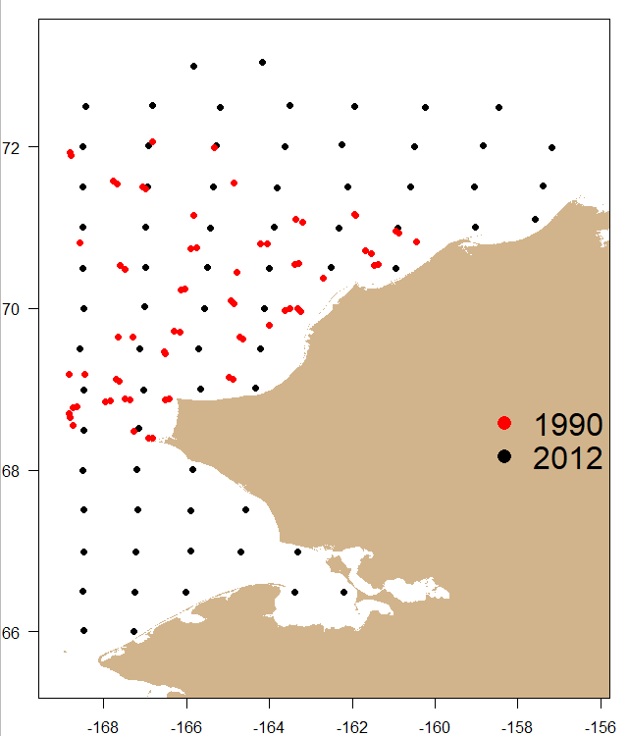
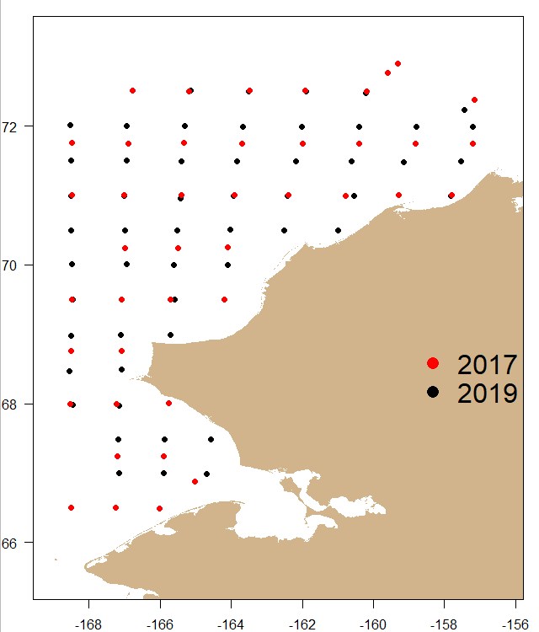
Data Sources: Catch and Effort
Otter Trawl: 1990 and 2012
Beam Trawl: 2017, 2019

Slide 3
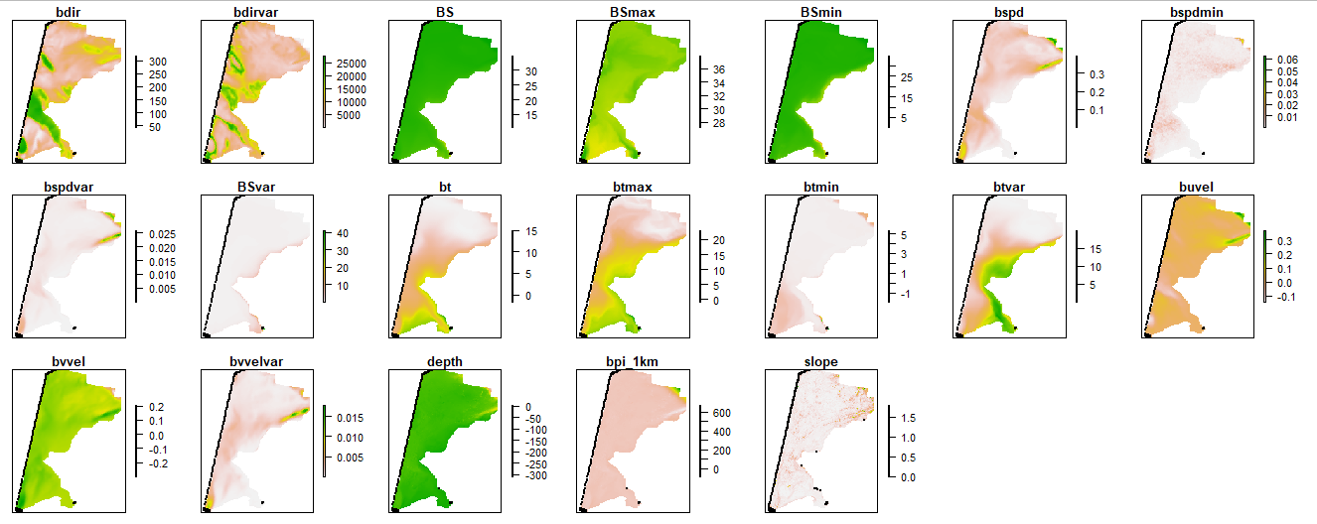
Data Sources: Covariates (Marsh and Pirtle)
Notes:
Many of the bathymetric covariates are pretty flat. Current direction or bottom temperature may be the better covariates.

Slide 4
Model Settings
50 knots: 25 too low and 75 is too high (convergence issues)
Multispecies: Arctic cod, Bering flounder, saffron cod, Alaska plaice, yellowfin sole, snow crab, walleye pollock
based on number of records
Anisotropy turned off (convergence issues, high gradients)
Tested out different FieldConfig settings

Slide 5
Spatial/Spatiotemporal Field Configurations (RRMSE)
Otter Trawl
Omega 1 | Omega 2 | Epsilon 1 | Epsilon 2 | Anisotropy? |  | Alaska plaice | Arctic cod | Bering flounder | saffron cod | walleye pollock | yellowfin sole | average
2 | 2 | 0 | 0 | F |  | 3.26 | 1.53 | 1.31 | 5.39 | 5.03 | 2.21 | 3.12
2 | 2 | 2 | 2 | F |  | 2.93 | 1.39 | 1.18 | 3.79 | 3.48 | 2.53 | 2.55
2 | 3 | 2 | 2 | F |  | 3.05 | 1.39 | 1.17 | 3.80 | 3.54 | 2.53 | 2.58
2 | 2 | 2 | 3 | F |  | 2.93 | 1.39 | 1.18 | 3.79 | 3.48 | 2.53 | 2.55
Beam Trawl
Omega 1 | Omega 2 | Epsilon 1 | Epsilon 2 | Anisotropy? |  | Arctic cod | Bering flounder | Saffron cod | Snow crab | Walleye pollock | average
2 | 2 | 0 | 0 | F |  | 1.61 | 2.95 | 1.89 | 2.32 | 3.06 | 2.37
2 | 2 | 2 | 2 | F |  | 1.34 | 2.73 | 2.01 | 2.07 | 2.75 | 2.18
2 | 3 | 2 | 2 | F |  | 1.35 | 2.74 | 1.96 | 2.08 | 2.75 | 2.18
2 | 2 | 2 | 2 | T |  | 1.35 | 2.71 | 2.03 | 2.06 | 2.75 | 2.18

Slide 6
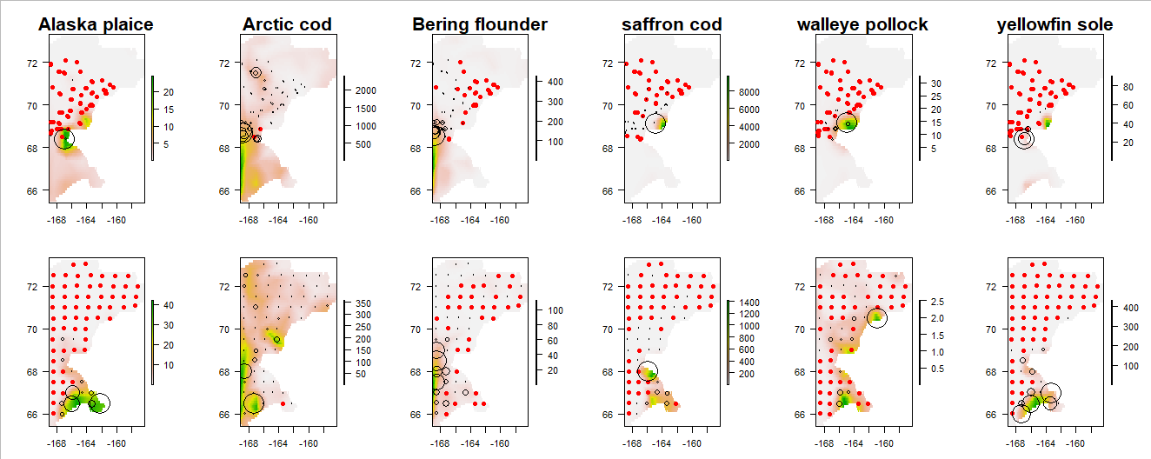
Predicted Density: Otter Trawl
1990
2012

Slide 7
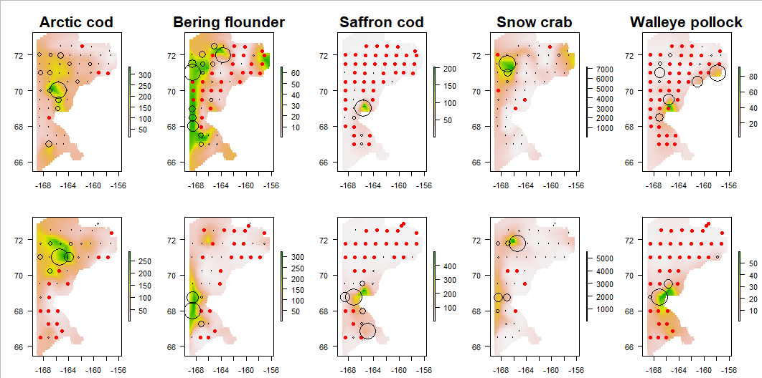
Predicted Density: Beam Trawl
2017
2019

Slide 8
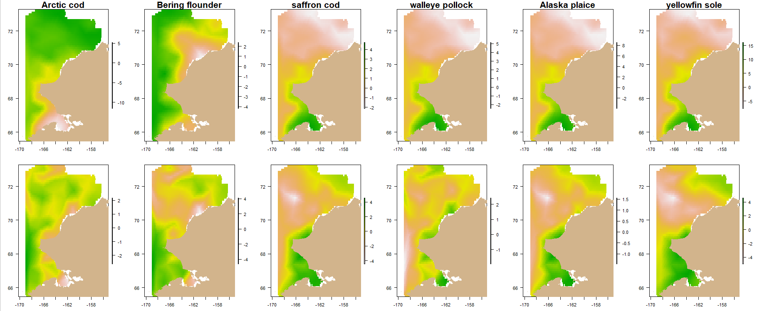
Spatial Effect: Otter Trawl
Occ.
+ Resp.

Slide 9
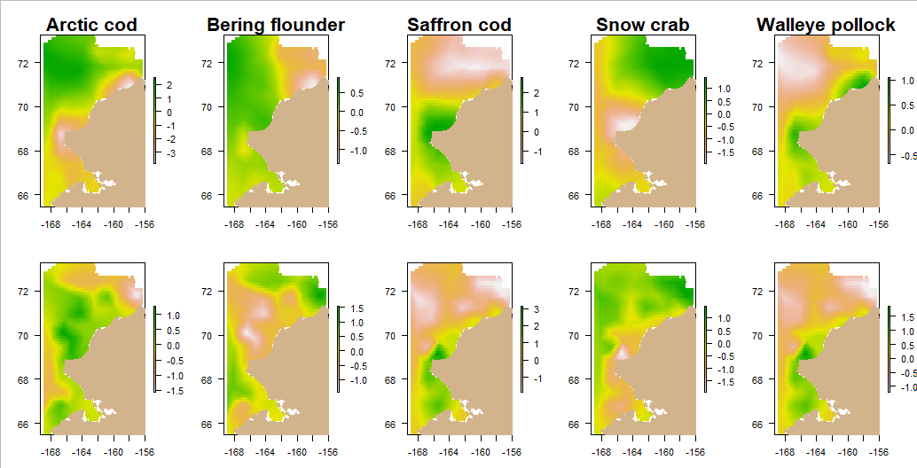
Spatial Effect: Beam Trawl
Occ.
+ Resp.

